Slide 1
Robust and Multi-disciplinary Design Optimization with Applications on Tolerance Design
by
Jianhua ZHOU
July 21, 2015
Advisory Committee:
Dr. Mian Li, Chair/Advisor
Dr. Min Xu
Dr. Chien-Pin Chen
Dr. David Hung
Dr. Chengbin Ma
Notes:
Thank you Professor Li, Good afternoon everyone. Before I start, I would like to thank all committee members and all other audients to come to my defense.
The topic of my dissertation is

Slide 2
Outline
Motivation and Objective
Definition and Terminologies
Robust optimization (RO)
Multi-disciplinary optimization (MDO)
Research Focus in Dissertation
Research Thrusts
Thrust 1: RO based on SQP (SQP-RO)
Thrust 2: Single-looped RO approach (A-SQP-RO)
Thrust 3: Sequential MDO method (S-MDO)
Thrust 4: Application on tolerance design for gas engines
Concluding Remarks
Notes:
Here is the outline. First is the motivation and objective of this work, then comes the definition and terminologies used in this dissertation, thirdly, I will talk about the research focus in this dissertation, followed by the research thrusts, including 1,2,3,4… finally comes the concluding remarks and main contributions.

Slide 3
Outline
Motivation and Objective
Definition and Terminologies
Robust optimization (RO)
Multi-disciplinary optimization (MDO)
Research Focus in Dissertation
Research Thrusts
Thrust 1: RO based on SQP (SQP-RO)
Thrust 2: Single-looped RO approach (A-SQP-RO)
Thrust 3: Sequential MDO method (S-MDO)
Thrust 4: Application on tolerance design for gas engines
Concluding Remarks
Notes:
Here comes to the motivation and objective of the research.

Slide 4

Motivation and Objective
Tolerances of parts & measurement errors
Compression ratio &
Friction loss
*
In engineering design optimization, we may have to consider
Uncertainty due to uncontrollable variations
Multiple disciplines
Computational efficiency has to be improved
Objective: Develop efficient robust optimization approaches and multi-disciplinary optimization methods with applications on tolerance design of gas engines
* Picture from SGMW.
Notes:
Nowadays engineering systems are becoming more and more complex. E.g., the engine is a complex system. And in engineering design optimization, we may have to consider the following issues:
1….. E.g., for an engine, tolerances of parts and measurement errors of experiments, and they contribute to uncertainty
2, usually there are multiple discipline involved. e.g., for an engine, the compression ratio and the friction loss are two of the most important disciplines that will affect the system performance.
3. Given these complexities, efficient optimization methodologies are needed to deal with uncertainty and multiple disciplines.
So the objective of this research is to …. The terminologies will be explained right now.

Slide 5
Outline
Motivation and Objective
Definition and Terminologies
Robust optimization (RO)
Multi-disciplinary optimization (MDO)
Research Focus in Dissertation
Research Thrusts
Thrust 1: RO based on SQP (SQP-RO)
Thrust 2: Single-looped RO approach (A-SQP-RO)
Thrust 3: Sequential MDO method (S-MDO) based on sequential MOO approach (S-MOO)
Thrust 4: Application on tolerance design for gas engines
Concluding Remarks and Main Contributions
Notes:
Then let’s take a look at the definitions and terminologies used in this work.

Slide 6
Deterministic and Robust Optimization
Definition of deterministic and robust optimization
f : objective function
g_{j}: inequality constraints
h_{i}: equality constraints
x: vector of design variables
Uncertainty
deterministic optimum
Probability based:
Lots of history data needed
Interval based:
Lower and upper bounds needed
Commonly used in ME, e.g., diameter of a shaft is Φ10±0.005mm
f
f
deterministic
robust
optimum
robust
x*
x_{R}*
-Δp
p₀
Δp
Notes:
Here we provide the definition for optimization.
First for deterministic optimization, the formulation is shown here, f,g,,h,(the equality constraints can be transformed to inequality constraints) x…. E.g., in this figure, this point gives the minimum function value and is the deterministic optimum.
On the contrary to deterministic optimization, for robust optimization, uncertainties have to be taken into consideration. That is, p is not fixed at p0, but varies within this interval, and the robust solution lies here.
What’s the difference between the two solutions? As shown in this figure, when the parameter varies within the uncertainty interval, the objective variation of the deterministic case is much larger than the robust case. And the variation for the robust case is what we can accept.
Generally, there are two types of uncertainties: probability based and interval based. Probability based uncertainties use the probability distribution, like mean and standard deviation, to represent uncertainty, and this needs a lot of history data. While interval uncertainty only uses the lower and upper bounds, as is shown here. It is also commonly used in ME. E.g., the diameter of a shaft is

Slide 7
Robust Optimization (RO)
Worst-case RO formulation*:
Inner optimization problems
Leads to “double-looped”
* Li, M., 2007, “Robust Optimization and Sensitivity Analysis with Multi-Objective Genetic Algorithms: Single- and Multi-disciplinary Applications,” PhD dissertation, Department of Mechanical Engineering, UMD, USA.
Notes:
In this case, we would like to show the worst case RO formulation. Compared to the previous general formulation, two additional constraints are included, they are the robustness indices for the objective and constraints.
The objective robustness index is illustrated in this figure. This bar shows the acceptable objective variation region delta f0. the solid line shows the nominal objective value, and the dashed lines show the variation due to uncertainty. The robustness index ensures that the variation of the objective should always be within delta f0.
The constraint robustness index is illustrated here. This is the nominal value, and the dark area shows the variation region. The constraint robustness index ensures that no matter how the constraint varies, it should always be within the feasible region that g is no larger than 0.
Note that those robustness indices formulate the inner optimization problems, this leads to a double-looped optimization problem, such that it becomes computationally burdensome.

Slide 8
Multi-discipline Optimization (MDO)
x₁
f₁, g₁
Multi-objective optimization (MOO):
Discipline 1
z
output
y₁
y₂
f, g
Discipline 2
x₂
f₂, g₂
x_{i}: Local design variables of discipline i
z : Global design variables of discipline i
y_{i}: Coupling variables, output from
discipline i and input to other
disciplines
f_{i} : Objective function of discipline i
g_{i}: Inequality constraints of discipline i
A_{j}: Analysis of discipline i
Notes:
This slide shows the formulation of an MDO problem.
Here we use a two-disciplinary system to illustrate the problem formulation. We have two disciplines, 1 and 2. discipline 1 has design variable x1, and x1 only appears in discipline 1. also x2 for discipline 2. x1 and x2 are called local design variables, since they only occur in one discipline.
There are global design variables z that appears in both disciplines. y1 and y2. y1 is the output of discipline 1 and input to discipline 2.
F1,g1,f2,g2,…
Note that if no coupling variables exist, then this MDO problem can be regarded as a multi-objective problem MOO.

Slide 9
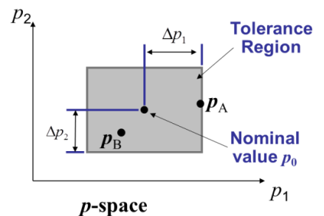
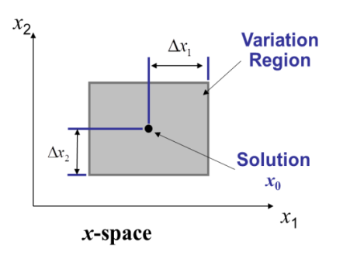
Research Focus
Deterministic Optimum
Uncertainty
f
x*
Pareto Optima
Global and Coupling
MOO and MDO
Full autonomy optimization
Sequential optimization
Notes:
Given the background, there are two perspectives of the research focus. First considering uncertainties, we are going to develop efficient RO methods to quickly determine the robust optimum solution.
Then considering the global and coupling variables, we use full autonomy and sequential optimization strategies to solve for the Pareto optimum. The full autonomy and sequential strategies will be discussed later.
What is Pareto optima. Usually trade-offs exist between the two objectives. If we want to minimize f1 and f2 at the same time, we cannot obtain a single solution but a bunch of solutions, and for all the Pareto solutions, there is not one solution that is able to say I am the best, since compared to all the other solutions, if a have a smaller f1, I do have a larger f2. in the same way, if I have a smaller f2, I do have a larger f1.

Slide 10

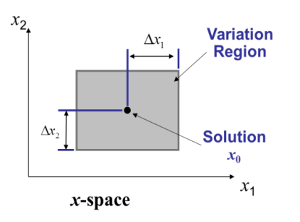
Research Thrusts
RESEARCH THRUST 1: Sequential Quadratic Programming for RO
SQP-RO
RESEARCH THRUST 2:
Advanced Single-looped
SQP-RO
A-SQP-RO
RESEARCH THRUST 3: Sequential MOO and Sequential MDO
S-MDO
RESEARCH THRUST 4: Multi-disciplinary Tolerance Design Formulation and Solution
Notes:
This shows the research thrusts:
First we propose SQP for RO, and to improve the computational efficiency further, we develop a single-looped RO algorithm in research thrust 2. Then for MDO problems, we propose sequential MOO and MDO approaches. Finally in research thrust 4, case studies for the entire research work are presented.

Slide 11
Research Thrust 1
RESEARCH THRUST 1: Sequential Quadratic Programming for RO
SQP-RO
RESEARCH THRUST 2:
Advanced Single-looped
SQP-RO
A-SQP-RO
RESEARCH THRUST 3: Sequential MOO and Sequential MDO
S-MDO
RESEARCH THRUST 4: Multi-disciplinary Tolerance Design Formulation and Solution
Notes:
Then we come to the discussion of research thrust 1.

Slide 12
Research Thrust 1*: Motivation and Objective
Motivation
Uncontrollable variations exist in parameters or design variables
RO involve an inner-outer double-looped structure
Efficient methods to solve most kinds of problems are needed
SQP is an efficient solver to be applied
p₂
p₁
f
x
Objective: Develop an efficient robust optimization algorithm based on SQP to solve problems with interval uncertainty
* Zhou, J. H., Cheng, S., and Li, M., 2012, “Sequential Quadratic Programming for Robust Optimization with Interval Uncertainty,” Journal of Mechanical Design, 134(10), pp. 10091301-10091313.
Notes:
The motivation is that, as mentioned previously, uncertainty…
SQP is an efficient solver, which will be introduced later.

Slide 13
Previous Work
Example Refs. | Probability necessary | Gradient-based | Non-gradient based | Computationally efficient
Youn, et al, 2003; | ✓ | ✓ |  | ✓
Du and Chen, 2004; |  | ✓ |  | ✓
Tang, et al., 2012; |  | ✓ |  | ✓
Soyster, A. L., 1973; |  | Linear problems |  | ✓
Bertsimas, D., and Sim. M., 2006; |  | ellipsoidal uncertainty set
Li, M., 2007; |  |  | ✓
Saha, and Ray, 2011;
SQP-RO |  | ✓ |  | ✓
Notes:
a lot of RO methods have been proposed, and the typical ones are reviewed here.
These approaches are probability based, and lots of history data are needed.
These two approaches are interval based, but they use non-gradient based algorithms as the solver, and is computationally inefficient. Our proposed does not need probability information, and applies gradient based solver, such that it is computationally efficient.

Slide 14
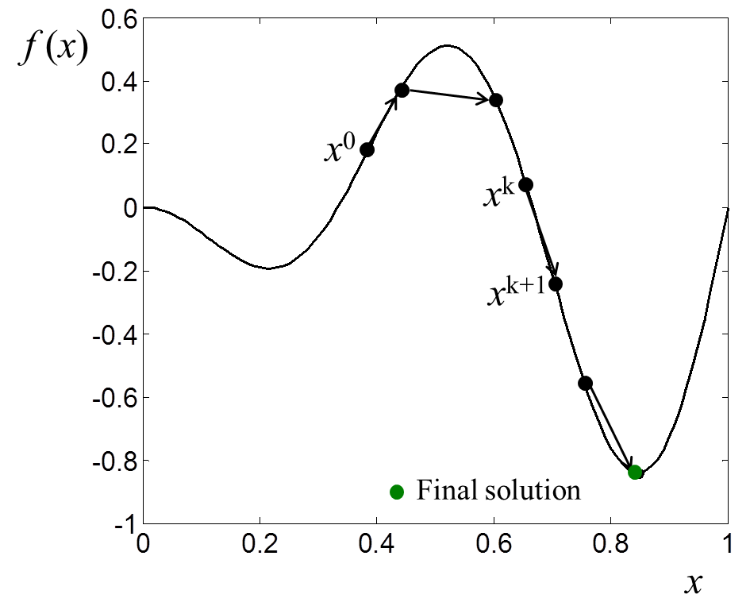
Background: SQP*
Sequential Quadratic Programming:
Sequential method:
Start
Initialization: iteration number k=0, convergence tolerance ε, and x₀
Solve for d^{(k)}
Update k=k+1,
x^{(k+1)}=x^{(k)} +d^{(k)}
Quadratic Programming:
N
Y
x^{(k)} is solution
* Arora, J. S., 2004, “Introduction to Optimum Design”, 2nd eds., Elsevier, New York, USA.
Stop
Notes:
Now let’s take a look at the SQP methodology as a background in this research thrust.
First, a sequential method searches for the solution from a starting point x0 to x1, to xk and then to the final solution step by step.
For quadratic programming, it has a quadratic objective with linear constraints.
If they are combined together, we will obtain the SQP methodology: start, initialization settings, e.g., the initial starting point. Then Taylor’s expansion is applied to get the quadratic formulation, the objective is approximated to the second order and the constraints to the first order with respect to the step size d. solve for d, if it is small enough, say 10 (-5), stop, if not, update x and continue to find d until it is small enough.

Slide 15
SQP-RO
Difficulty arises: SQP cannot directly deal with absolute value constraints that are non-differentiable
Solution: transform the objective and constraint robustness index such that they are differentiable and can be linearized.
recall
Equivalent to
Easy way
p_{max} for objective
p_{max}
p₂
p₀
p_{jmax}
p_{jmax} for constraint j
p₁
Notes:
Recall the robustness constraints that contribute to the inner optimization problem. Difficulty arises since SQP cannot directly deal with the problem shown here since it is an optimization problem with absolute values.
So we transform the indices such that they are differentiable and can be linearized. For the objective robustness index, the absolute value is equivalent to this squared value, and the constraint robustness index can be expressed in an easy way that no matter how p varies, the constraint should always be non-positive. These two problems can now be solved and pmax is found which leads to the maximum variation of the objective, and pjmax is found which leads to the maximum variation of the constraint. Pamx and pjmax are substituted to the equation. Thus the inner optimization problem is solved and can be linearized with this formulation.

Slide 16
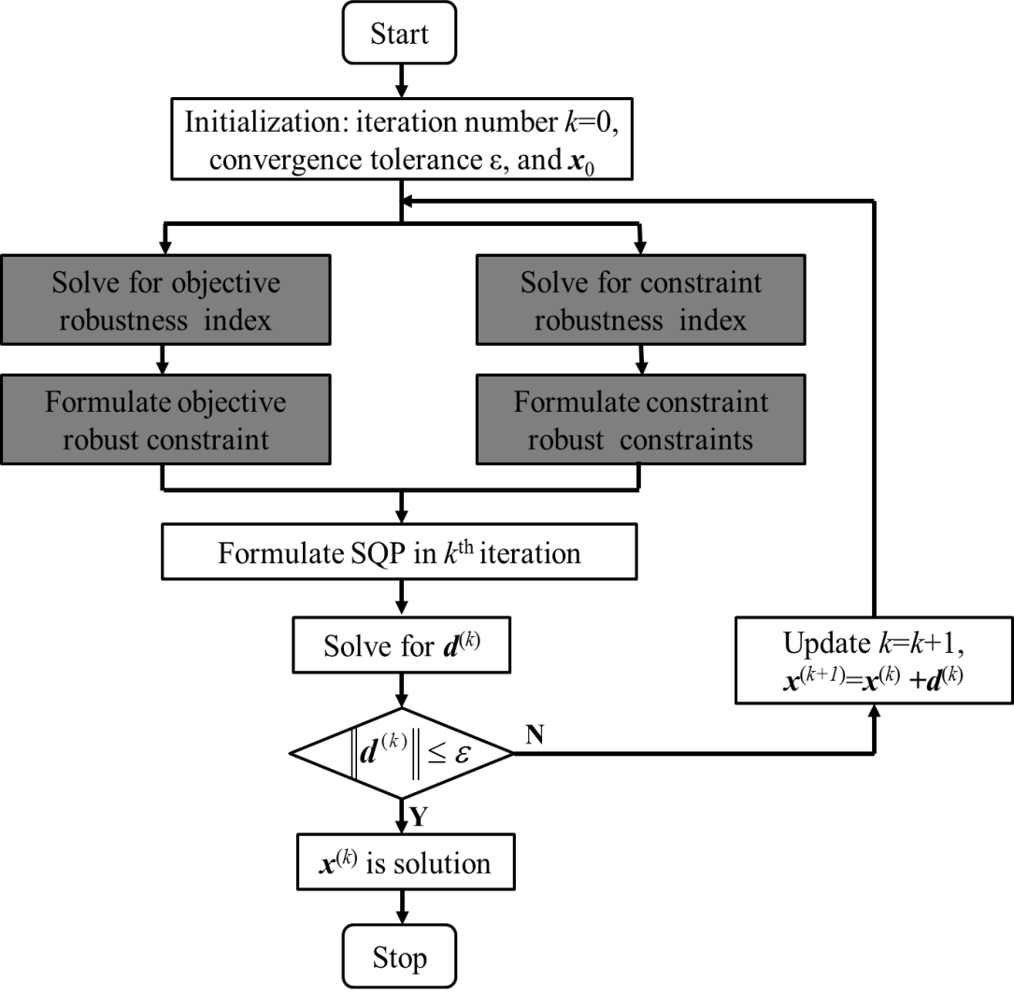
SQP-RO
Flowchart of SQP-RO:
Formulation of SQP-RO:
Notes:
The flowchart for SQP-RO is shown here. It shares a similar structure with SQP, and the dark blocks show the procedure we have just discussed.
The formulation gives the detailed procedure for the flowchart.

Slide 17
Engineering Example - Formulation
Compressing spring*
Minimize Spring Deflection
s.t.:
Shear stress ≤ 80 ksi
Surge wave frequency ≤ 100 Hz
Outer diameter ≤ 1.5 in
Total mass ≤ 2.309 x 10⁻⁵ lbm
spring deflection ≤ 0.75 in
Design Variables (x):
0.05 ≤ wire diameter (d) ≤ 0.20
0.25 ≤ the mean coil diameter (D) ≤ 1.30
2 ≤ # of active coils (N) ≤ 15
Uncertainty & Acceptable Objective Variance: [Δd, ΔD, ΔP] = [0.001in, 0.01in, 0.1lbf]
Acceptable objective variance: Δδ = 0.1
Solution | Deterministic | Robust
d | 0.0765 | 0.0525
D | 1.3000 | 0.3372
N | 6.3602 | 14.9000
*Gunawan, S., 2004, “Parameter Sensitivity Measures for Single Objective, Multi-Objective, and Feasibility Robust Design Optimization,” PhD dissertation, Department of Mechanical Engineering, UMD, USA.
Notes:
With the SQP-RO proposed, now we give an engineering example to show the applicability of the proposed approach.
This Is a compressing spring. we want to design the wire diameter, the coil diameter, and the number of coils to minimize the spring deflection.
Uncertainties exist in two of the diameters and the force applied. The acceptable objective variation is 0.1.
Note that the number of coils should be rounded. in practical engineering design, we should go back to check whether the design is still feasible with the rounded number of coils. But here, we did not repeat this procedure.

Slide 18
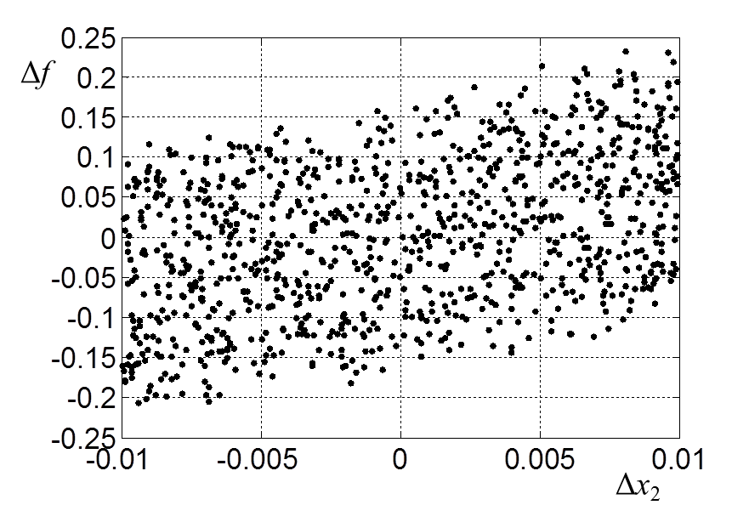
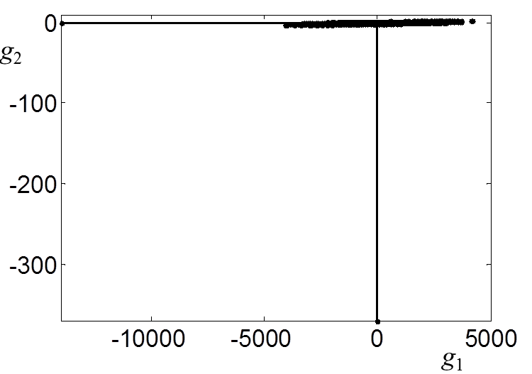
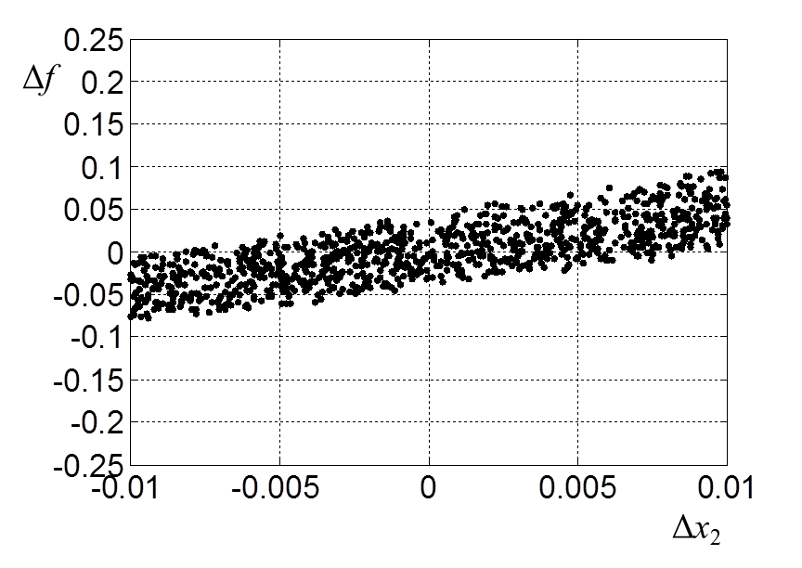
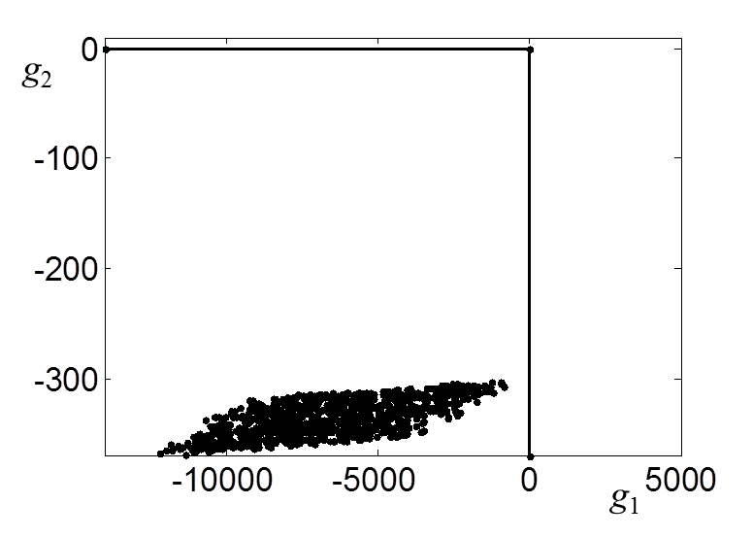
Engineering Example - Results
Solution
Deterministic case
Robust case
D=0.3372
N=15
d=0.0525
D=1.3000
N=6
=0.0765
Monte Carlo simulation results
Notes:
The minimum deflection of the robust solution is larger than the deterministic solution, but the objective variation due to uncertainty of the robust case is smaller than the deterministic case.
The two springs are with different dimensions.
We did [ˈmɑntiˈkɑrlo] simulations to show the robustness of the two solutions. It is shown that for the deterministic case, the variation of the objective reaches 0.25, which is larger than the allowed 0.1, and also the constraint are violated. But for the robust solution, the variation of the objective is within 0.1, and the constraints are satisfied.

Slide 19
Comparison of Results
Computational Efficiency of Five Numerical Examples
Computational Efficiency of Three Engineering Examples
Notes:
We also tested other numerical and engineering examples, the computational efficiency is listed here. The number of function evaluations of SQP-RO is at most five times of the deterministic SQP. It should be noted that for other algorithms like GA, the number of function evaluations of the robust case could be hundreds times of the deterministic case. The deterministic case is set as a baseline here.
The computational time is also shown, and compared to the deterministic case, SQP-RO also shows its efficiency.

Slide 20
Case Study: Robust Optimization of Compression Ratio
Problem description*: robust tolerance design optimization
V_{c} : the minimum volume of the cylinder
V_{s} : the piston swept volume
V₁ : combustion chamber volume of the piston
V₂ : combustion chamber volume of the cylinder
cover
V₃ : bore volume of the cylinder cover gasket
V₄ : combustion chamber volume of the cylinder
V₅ : volume of clearance between the piston and
cylinder
*Gong, H., Xu, M., Li, M., Yuan, Z. Y., Qin, J. H., and Yang, X., 2014, “Tolerance Optimization for Improvement of Consistency in Engine Performance”, Chinese Internal Combustion Engine Engineering, accepted.
Notes:
This is a case study of the proposed approach. The compression ratio is one of the most important factors that will affect the performance of the engine. And this case study is based on the published literature.
This is an illustration of a cylinder /’cilinder/, the compression ratio can be calculated using this equation, and the physical meaning of each parameter is listed here.
Most of the volumes can be calculated by the physical size of the corresponding components. Among all those dimensions, we choose the six dimensions that have the largest impacts on the variation of the compression ratio as the critical dimensions, and the others are non-critical dimensions. So we have this equation of compression ratio with respect to the critical dimensions.

Slide 21
Case Study: Robust Optimization of Compression Ratio
Critical dimensions and control factor (design variables)
+Δr_{c}
+Δh
A larger x_{i} means to shrink the tolerance a little
A smaller x_{i} means to shrink the tolerance a lot
In this case study, measurement errors are considered as uncertainty
r_{c} is with uncertainty of max Δr_{c} = 0.005 mm
h is with uncertainty of max Δh = 0.005 mm
Notes:
The critical dimensions with their tolerances are shown in this data, and all the data are from the industry. With those tolerances, the maximum variation of the compression ratio could reach 0.4. we propose to use control factors as listed here, x1 to x6, to redesign the tolerances such that the maximum variation of the compression ratio is within 0.2. a larger xi means to shrink the tolerance a little, and a smaller xi means to shrink the tolerance a lot.
In this case study, measurement errors are taken into consideration as uncertainty: under the measurement errors, we still want the maximum variation of the compression ratio stay within 0.2.
Here we consider the measurement errors of two dimensions:

Slide 22
Case Study: Robust Optimization of Compression Ratio
Problem formulation
To maximize the control factors, i.e., to keep the redesigned tolerances close to the original tolerances as much as possible
The maximum CR variation should be within ±0.2
Uncertainties
Computational results
Notes:
The problem formulation is shown: the objective is to maximize the control factors, that is, we want to keep the redesigned tolerances close to the original tolerances as much as possible such that we do not have to make many changes but only necessary changes.
The constraint is to ensure that the maximum variation of the compression ratio is within 0.2. also under the consideration of the uncertainties.
The computational results are listed in this table. Note that GA computes the deterministic case that does not taken uncertainty into consideration, even though, it spends much more computational efforts than the robust SQP-RO.
Considering the actual manufacturing conditions of the factory, the lower and upper bounds of the control factors can also be different. For those dimensions that already have high manufacturing precision, the control factors can be set at a smaller value, but for those dimensions that have a high rejection rate, the control factors can be set as a larger value.

Slide 23
Research Thrust 2
RESEARCH THRUST 1: Sequential Quadratic Programming for RO
SQP-RO
RESEARCH THRUST 2:
Advanced Single-looped
SQP-RO
A-SQP-RO
RESEARCH THRUST 3: Sequential MOO and Sequential MDO
S-MDO
RESEARCH THRUST 4: Multi-disciplinary Tolerance Design Formulation and Solution
Notes:
Then we come to research thrust 2: a single-looped RO approach

Slide 24
Research Thrust 2*: Motivation and Objective
Outer
optimization problems
Motivation
Most existing RO methods are of inner-outer double-looped structure
Efficient methods are needed to solve most kinds of problems
Inner optimization problems
Objective: Develop an efficient single-looped RO algorithm to solve problems with interval uncertainty.
*Zhou, J. H., and Li, M., 2013, “Advanced Robust Optimization with Interval Uncertainty Using a Single-Looped Structure and Sequential Quadratic Programming,” Journal of Mechanical Design, 136(2), pp. 02100801-02100811.
Notes:
The motivation of this study is that most existing RO approaches including the previously developed SQP-RO, have a double-looped structure, that is, the inner optimization problem have to be solved and then the outer optimization problems.
We are searching for a single-looped RO approach to improve the computational efficiency further.

Slide 25
Previous Work
Example Refs. | Types of problems | Double-looped | Single-looped | Probability necessary
Ben-Tal, et al., 1999; | Linear | ✓ |  | Not all
Ben-Tal and Nemirovski, 2000; | Linear
Bertsimas, et al., 2004; | Linear
Ben-Tal, A., and Nemirovski, A., 1998 | Convex
Lobo, 2000; | Convex
Zhou, et al., 2012; | Differentiable
Liang et al., 2007; |  |  | ✓ | ✓
A-SQP-RO | Differentiable |  | ✓
Notes:
Also we listed typical RO approaches.

Slide 26
Quadratic Problem
Recall the inner optimization problem—the robustness indices:
Optimization problems defined on an interval, i.e.
subject to small box constraints, a special case of linear constraint
It can be approximated to a Quadratic Problem—Taylor’s expansion:
x₂
: box constraints
: objective contours
0
x₁
Symmetry axis of the ellipse is not parallel with box in this case
Notes:
Recall the inner optimization problem to solve for the robustness indices, they are defined on an interval. They are optimization problems subject to small box constraints, a special case of linear constraints.
So first we are considering to approximate these problems to quadratic problems using Taylor’s expansion. This figure shows a 2-dimensional problem, the red box is the constraint region, and the ellipse shows the objective contours.
Note that the symmetry axis of the ellipse is not parallel with the box, which means the variables are coupled with each other.

Slide 27
Quadratic Problem
Things will become easier if…
e.g.:
x₂
: box constraints
: objective contours
: optimal solution
0
x₁
HOW?
Difficulties:
Diagonal matrix
Parallelization
x₂
y₂
Solutions:
Matrix decomposition
Utopian box
0
x₁
y₁
Notes:
But things will become much easier if the symmetry axis of the ellipse is parallel with the box, since we can easily identify the optimal solution without any optimization procedure. What’s the character of this kind of problems? As shown here, it should have a diagonal matrix, such that the variables do not couple with each other, and the optimal solution can be identified easily.
How can we reach this perfect case?
As mentioned previously, difficulties are we need diagonal matrix as well as parallelization /parerilai’zation/.
The solution is also proposed: to get diagonal matrix, we apply matrix decomposition. And to get parallelization, we propose to use the Utopian box, as shown with the blue box. It covers the original box and is parallel to the symmetry axis of the ellipse. Next the two solutions will be discussed.

Slide 28
Matrix Decomposition* and Utopian Box
In SQP, H (Hessian matrix) is real and symmetric, so
Normalized
Eigenvectors of H,
such that U^{T}U=I
Eigenvalues of H
x₂
y₂
: original box
x₁
: Utopian box
: (y_{1max}, y₂), optimal for y₁
: (y₁, y_{2max}), optimal for y₂
0
y₁
: (y_{1max}, y_{2max}),Utopian point
* Floudas, C. A., and Visweswaran, V., 1995, “Quadratic optimization,” in Handbook of Global Optimization, R. Horst and P. M. Pardalos, eds., Kluwer Academic Publishers, Dordrecht, The Netherlands, pp. 217–269.
Notes:
In SQP, the Hessian matrix is real and symmetric, so it can be decomposed as UtDU. Lambda are the eigenvalues of H, and these are the normalized eigenvectors of H such that UtU is the identity matrix.
Then we can replace H with UtDU, and also replace Ux with y, and we the diagonal matrix.
For the Utopian box, we find the minimum box that can cover the original box. First, we identify the individual optimal point for each variable, and then the Utopian point can be obtained and then the Utopian box is obtained.
By doing so, the inner optimization problem becomes a quadratic problem with the symmetry axis of the ellipse parallel with the Utopian box, and the optimal solution can be easily obtained without any optimization procedure. We only have to solve the outer optimization problem.

Slide 29
Formulation of A-SQP-RO
There is no inner optimization problems, but just matrix calculations
Notes:
The formulation of A-SQP-RO is shown here, for the outer problem, the original objective is replaced with the quadratic problem, all the constraints are linearized.

Slide 30
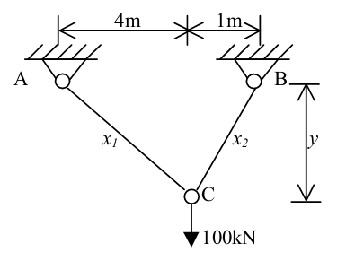
Engineering Example
Two-Bar truss*
Minimize Stress in AC
s.t.:
Volume ≤ 0.1 m³
Stress in AC ≤ 10⁵ kPa
Stress in BC ≤ 10⁵ kPa
Design Variables (x):
10⁻⁴ m² ≤ cross-sectional areas of AC ≤ 0.25 m²
10⁻⁴ m² ≤ cross-sectional areas of BC ≤ 0.25 m²
1.0 m ≤ perpendicular distance from AB to C ≤ 3.0 m
Solution
x & f | SQP-RO | A-SQP-RO
x₁ | 0.0197 | 0.01956
x₂ | 0.0002 | 0.0002
y | 2.9250 | 2.9250
f | 1.7240 | 1.7322
Variations in design variables are [0.000125m², 0.000125m², 0.075m]
Acceptable objective variance is Δf = 1
*Azarm, S., Reynolds, B. J., and Narayanan, S., 1999, “Comparison of Two Multiobjective Optimization Techniques with and within Genetic Algorithms,” Advances in Design Automation, Las Vegas, NV, ASME, Sept. 12–15, 1999, Paper No. DETC99/DAC-8584.
Notes:
Based on the these discussions, we use this engineering example to shown the applicability of the proposed approach.
This two-bar truss problem is to design the cross-sectional areas of the bars and the perpendicular distance from AB to C such that the stress in AC is minimized.
Variations exist in the three design variables, and the acceptable objective variance is 1.
The solutions are shown here.
Although approximation is utilized in A-SQP-RO, the solution it obtained is very close to the solution obtained by SQP-RO..

Slide 31
Comparison of Results
Computational Efficiency of Four Numerical Examples
Computational Efficiency of Two Engineering Examples
Notes:
Other numerical and engineering examples are also tested to show the efficiency of the proposed approach.
It is shown that the number of function evaluations and the computational time of A-SQP-RO are smaller than SQP-RO. This shows the improved computational efficiency of the newly proposed single-looped approach.

Slide 32
Case Study: Robust Optimization of Compression Ratio
Computational results
Notes:
We did the same case study of robust tolerance desing optimization of compression ratio. The computaional results are shown in this table. That the single-looped algorithm has the smallest number of function calls.
At the cost of sacrificing the computational accuracy a little.

Slide 33
Research Thrust 3
RESEARCH THRUST 1: Sequential Quadratic Programming for RO
SQP-RO
RESEARCH THRUST 2:
Advanced Single-looped
SQP-RO
A-SQP-RO
RESEARCH THRUST 3: Sequential MOO and Sequential MDO
RESEARCH THRUST 3: Sequential MOO and Sequential MDO
S-MDO
RESEARCH THRUST 4: Multi-disciplinary Tolerance Design Formulation and Solution
Notes:
Next we come the research thrust three. MDO approach development.

Slide 34
Research Thrust 3*: Motivation and Objective
Motivation:
Most existing methods do not give full autonomy to subsystems, i.e., subsystems only perform optimization with respect to its local variables
There is nested optimization between system and subsystems, calculation is burdensome
Objective: propose a novel MDO (MOO) approach which gives full optimization autonomy to the subsystems in the initial stage, and subsystems perform optimization in a sequential way
*Zhou, J. H., Li, M., and Xu, M., 2015a, “A New Sequential Multi-Disciplinary Optimization Method Based on A Novel Sequential Multi-Objective Optimization Approach”, Journal of Mechanical Design, under review.
Notes:
For most existing MDO approaches, they do not give full optimization autonomy to each subsystems, that is, the system determines the shared global and coupling variables and send them to the subsystems. The subsystems only perform optimization w.r.t. their local variables.
This also lead to another problem that there is nested optimization between the system and subsystems, such that the calculation is very burdensome.
So the objective of this research is to propose////

Slide 35
Previous Work
Example Refs. | Single-level | Multi-level | Disciplines have full optimization autonomy | Optimization structure
Cramer, et al., 1993, MDF | ✓
Cramer, et al., 1993, IDF
Haftka, R. T., 1985, AAO/SAND
Shin and Park, 2005, MDOIS
Sobieszczanski-Sobieski, 1988, CSSO |  | ✓ |  | Nested
Sobieszczanski-Sobieski et al., 1998, BLISS
Braun, 1996, CO
Michelena, et al., 1999, ATC
S-MDO |  | ✓ | ✓ | Sequential
Notes:
Here list the typical MDO approaches.
These four approaches are single-level methods that can not deal with complex systems.
These approaches are multi-level methods but with nested optimization structure.
The proposed approach is also a multi-level method that gives subsystems full optimization autonomy and with a sequential optimization structure, such that the computational efficiency can be greatly improved.

Slide 36
Illustrative Observations
Single global variable and no local variable
f₂
f₁
f₂
f₁
Full autonomy optimization: identify the optimal solutions of each objective individually
Z₁₀ (z₁*)
Z₂₀ (z₂*)
z
f₂
f₁
f₂
B
A
C
Monotonicity check for two objectives
A
B
C
Z₁₀ (z₁*)
Z₂₀ (z₂*)
z
f₁
Potential Pareto points
Notes:
This slide shows a simplest case where the new idea comes from.
The simplest case is a two-obbjective optimization problem with only one global variable without any local variables, as shown in this figure.
Now we have f1 and f2, the minimum point of f1 and f2 can be determined using any optimization approach. It is found that out of the interval defined by z1 and z2, the [mɒnətə'nɪsɪtɪ] of the two objectives is the same with each other, as a result, it can be proved that points in this interval will contribute to the Pareto front. so only this interval should be considered.
Let’s consider another case. Still f1 and f2, the minimum solutions of f1 and f2. note that in this area beyond the interval defined by z1 and z2, the two objectives are with different monotonicity. As a result, points in this beyond region may dominate points in the interval. As A dominates B and C. so we have to expand the interval to this region to search for the Pareto front. as summarized in this flowchart, first we given ful optimization automony to find the individual optimal solutions, and then we check for the monotonicity of the two objectives in the region beyond the area defined by the individual optimal solutions, then we can determine the region that contain the potential Pareto points.
We discussed other cases as with local variables or more global varialbes,

Slide 37
S-MDO/S-MOO
Start
Stop
Y
N
# of points in F = s?
Full autonomy optimization of each subsystem
Subsystem 1
Subsystem 2
Non-dominated sorting of (f_{1k}*, f_{2k}*) & determination of Pareto front set F
z₁, y_{2_1}, y_{1_1}
z₂, y_{1_2}, y_{2_2}
System decision making and dispatching
x_{1k}*, f_{1k} *
z*_{eq k}, x_{2k}*, f_{2k}*
Z=expand[z₁, z₂]
Y₁=[y_{1_1}, y_{1_2}]
Y₂=[y_{2_1}, y_{2_2}]
Sequential optimization
f_{1k}*, one of x_{1k}* and y_{1k} or both
z_{k}*, y_{1k}(target),
y_{2k}(const.)
y_{2k} (target),
y_{1k} (const.)
Subsystem 1
Subsystem 2
Notes:
Flowchart for the proposed approach is shown. Start, full autonomy optimization, system making decisions and dispatching variables to subsystems, subsystems then perform optimization sequentially, non-dominated sorting of the obtained solutions, check for stopping criteria, if satisfied, stop, if not, the system dispatches other points.
There are mainly four major steps:

Slide 38
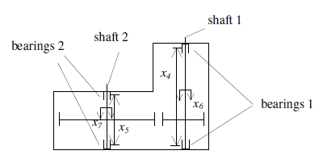
S-MOO Engineering Example
Minimize f1=volume of speed reducer
Minimize f2=stress in shaft 1
s.t.: Stress in shaft 2 ≤ 1100 kPa
Stress in shaft 2 ≤ 1100 kPa
.......
x₂, x₃, x₄, x₆
x₁, x₅, x₇
Subsystem 1
x₁ ~ x₇
min f₁
s.t. g₁≤ 0
Subsystem 2
x₂, x₃, x₄, x₆
min f₂
s.t. g₂≤ 0
Notes:
To show the applicability of the propose approach, we first give an MOO engineering example, the speed reducer.
We want to minimize the volume of the speed reducer and the stress in shaft 1.
These are local variables of subsystem 1, and these are shared global variables for both subsystems. The solution is shown in this figure. MOGA is multi0obbjective genetic algorithm, IDF is a single-level MDO approach and CO is a multi-level MOD approach as reviewed previously.
Our sequential method is able to find multiple Pareto solutions, but CO and IDF can find Pareto solutions with weighted suubm methods.

Slide 39
Numerical Example: S-MDO
x₁, x₂, x₃
Subsystem 1
x₁, x₂, x₃
min f₁
s.t. g₁≤ 0
y₁
Subsystem 2
x₁, x₂, x₃
min f₂
s.t. g₂≤ 0
y₂
39/54
Notes:
We give another numerical MDO example here.
The formulation is given, the relationship of the two subsystems are shown here, there are no local variables, but only global variables, and also coupling variables.
The solutions are also shown. The left figure gives the Pareto front, which is compared with IDF/MDF and CO. MDF is also a single-level MDO approach. The right figure shows the relationship between the two coupling variables. Just to give an image of how the two variables are coupled

Slide 40
Comparison of Results
Computational Efficiency of S-MOO Examples
Computational Efficiency of S-MDO Examples
Nomenclature of Tables
* GA is used as the optimizer
Notes:
We tested other MOO and MDO approaches, and the computational efficiency is listed in the tables.
First compared to MOGA, the total number of function calls or the number of function evaluations of the proposed approach is much smaller.
Compared to IDF and MDF, the average number of function calls is a little bit larger for most cases, and compared to CO, the average number of function calls is much smaller.
Average # of function calls is defined as the # of functions of each Pareto point.
IDF and MDF are two basic MDO algorithms and CO is a popular multi-level MDO appraoch.

Slide 41
Research Thrust 4
RESEARCH THRUST 1: Sequential Quadratic Programming for RO
SQP-RO
RESEARCH THRUST 2:
Advanced Single-looped
SQP-RO
A-SQP-RO
RESEARCH THRUST 3: Sequential MOO and Sequential MDO
RESEARCH THRUST 3: Sequential MOO and Sequential MDO
S-MDO
RESEARCH THRUST 4: Multi-disciplinary Tolerance Design Formulation and Solution
Notes:
Now we come to research thrust 4.

Slide 42
Research Thrust 4*: Motivation and Objective
Motivation:
There are rare studies on analysis models of how tolerance can affect performances
There are few literature talking about how to perform multi-disciplinary tolerance design optimization
Compression ratio and friction loss are two important disciplines for an engine
Tolerances of components
Compression ratio & Friction loss
Objective: Establish an analysis model between tolerances and performance, and handle the defined multi-disciplinary tolerance design optimization problem using S-MDO approach
*Zhou, J. H., Li, M., and Xu, M., 2015b, “Multi-disciplinary Tolerance Optimization for Internal Combustion Engines Using Gaussian Process and Sequential MDO Method”, Journal of Zhejing University, under review.
Notes:
The motivation of this research is that there are rare studies on analysis models of how

Slide 43
Background: GP Modeling*
Gaussian process modeling
Predict experimental results based on simulation model and discrepancy function using GP
y
1.Training data
3.Model prediction
×
×
Experimental output:
Same input, different outputs
Discrepancy function & experimental error
×
×
×
x
Model output:
Same input, same output
2.Make a prediction at this point
Able to model multi-input and multi-output problems
Gives distribution of prediction (mean value and uncertainty around it)
Experimental output
y
*Conti, S., and O'Hagan, A., 2010, “Bayesian Emulation of Complex Multi-Output and Dynamic Computer Models”, Journal of Statistical Planning and Inference, 140 (3), pp. 640-651.
Simulation model output
x
Notes:
We give the background introduction for Gaussian process modeling.
We have these training data or known data, and we want to predict the output at this point. By using Gaussian process modeling, we will get the distribution of the output at this point.
Gaussian process is chosen due to the advantages that it is able to model problems with multi-inputs and multi-outputs. Also it gives the distribution of the prediction with mean values and the uncertainty around. This character will benefit future studies on model uncertainty.
Based on GP, we are also able to predict the experiment result using simulation models. The relationship between the experiemental output and the simulation model output can be shown by this equation. Ye is the experimental output. As also shown in this figure. Note that we will obtain different experiment outputs even with the same inputs.
Ym is the simulation model output, as shown in this figure. For simulation models, the same inputs will always give the same outputs.
There are discrepancies between the experiment and simulation outputs. And this part can be modeled using discrepancy function as well as experimental errors.
Next GP models of performance vs. compression ratio as well as friction loss vs. tolerances will be introduced.

Slide 44
GP Modeling 1: Performances vs. Compression Ratio
Problem description
Torque
Compression ratio
GP
model
?
Power
BSFC
Data utilized for modeling: from simulation data and exp. results
Data sets
Training data | CR | [9.53, 9.58, 9.68, 9.78, 9.88, 9.98, 10.08, 10.18, 10.27]
 | Speed | [6000, 5200, 4400, 3600, 2800, 2000, 1200] rpm
Testing data | CR | [9.53, 9.58, 9.68, 9.78, 9.88, 9.98, 10.08, 10.18, 10.27]
 | Speed | [5600, 4800, 4000, 3200, 2400, 1600] rpm
Both simulation model and discrepancy function are modeled with GP, the experiment outputs can be estimated
Notes:
First, performance vs. compression ratio.
The input is the compression ratio, and the outputs are torque, power, and BSFC (Brake Specific Fuel Consumption). How to obtain the relationship between them? We use GP modelling.
This table lists the training data and testing data for the GP models. For the training data, both experiment data and simulation data are used. The testing data are from experiment results.
We then build the simulation model and discrepancy function uisng the training data based on GP. And then the experiment GP model can be obtained. Then tesing data are utilized to verify the experiment model.

Slide 45
GP Modeling 1: Performances vs. Compression Ratio
The curve of predicted values is smoother than curve of tested values
All tested points fall within interval of [predicted mean ± σ]
Notes:
These figures show the testing results.
Figures on the left show the three outputs individually at all inputs. Figures on the right show the detailed prediction results at coompression ratio of 9.88.
It is noted that the predicted curve is smoother than the original curve, and all the original values fall within the predicted uncertainty range.
This shows that the GP model we obtained works well and can be utilized to predict the experiment results.

Slide 46
GP Modeling 2: Friction loss vs. Tolerance
Problem description
Three groups of friction pairs:
Piston and the Cylinder
AVL Excite Piston&Rings
Crankshaft Bearing
AVL Excite Power Unit
Connecting-rod Bearing
Sensitivity analysis:
The output friction loss relates more to the clearances between the friction pairs: inputs of the GP model
The clearances relate to the dimensions: MDO tolerance design
Notes:
Then we build the GP model of friction loss vs. tolerances.
The relationship between the friction loss and tolerances can not be obtained by equations. Simulation models are built to study this relationship.
There are mainly three groups of friction pairs: 1,2,3,
Simulation model…
Then sensitivity analysis is performed to find the critical dimensions. It is found that the friction loss relates more to the clearances between the friction pairs,, and so the clearances are set as the inputs for the GP model.
Also the clearances can be calculated using corresponding dimensions, which will be discussed later in the multi-disciplinary tolerance design problem.

Slide 47
GP Modeling 2: Friction loss vs. Tolerance
Input spaces (sampling points)
Since three simulation models are independent of each other, sampling points are “badly” spaced
With experiment data included, still “badly” spaced
All data are utilized to build GP model
GP modeling results
Outputs from experimental training data are well fitted
Most of outputs from simulation training data are also well fitted
It is also found from this result that smaller clearances will give larger friction loss
Notes:
The input space or sampling space is shown in this figure. Note that there are three inputs.
Since the three simulation models are independent with each other, the sampling points are badly spaced, which means that they don’t cover the entire space. Even with experimental data added, it is still badly spaced. So we decide to use all the data to build the GP model.
The modeling results are shown in this figure. Note that the comparison is based on the training data since there are no extra data for testing currently. The vertical axis is the output friction loss. It is shown that all the experiment data are well fitted, and most of the simulation data are fitted well. Given this badly spaced sampling points, this result is satisfactory.
It is also noted that smaller clearances will lead to larger friction loss.

Slide 48
Multi-disciplinary Tolerance Design
Problem description
Compression ratio
Improve performance
s.t. constraints
Dimensions of CR
Output: optimal tolerances
Coupling between dimensions and clearances
Friction loss
Improve performance
s.t. constraints
Dimensions of FL
Problem definition
x_{1_1} ~ x_{1_9}
x_{2_1}, x_{2_2}, x_{2_3}
Subsystem 1
Compression ratio
x_{1_1} ~ x_{1_9}
Subsystem 2
Friction loss
x_{2_1}, x_{2_2}, x_{2_3}
Design variables for Subsystem 1: Coefficients for tolerances
Design variables for Subsystem 2: Coefficients for clearances
Connection lies in the main bearing friction pair
y₁
Notes:
Based on the formulation of compression ratio and the GP model for friction loss, we want to study the multi-disciplinary tolerance design optimization problem considering the two disciplines.
the problem is defined as follows: the objective is to maximize the control factors or design variables, and the variables for subsystem 1 are control factors for the tolerances; The variables for subsystem 2 are control factors for clearances. There is a connection between the two subsystems which lies in the main bearing friction pair

Slide 49
Multi-disciplinary Tolerance Design
Dimensions for the main bearing friction pair
Three dimensions are non-critical dimensions for compression ratio
Used to calculated clearance between bearing friction pair: y₁ = R₁ – r₁ – θ₁
Objectives
Main bearing shaft
r₁ = 24.50 mm
Constraints
[-0.0085, -0.0025]
Main bearing shell
θ₁ = 2.00 mm
Coupling
[-0.009, -0.004]
Main bearing bore
R₁ = 26.50 mm
Variable ranges
[0.0025, -0.0075]
Notes:
Dimensions for the main bearing friction pair are listed in the table. These dimensions are three of the non-critical dimensions for the compression ratio. These three dimensions can also be utilized to calculate the clearance of this friction pair, as illustrated in this figure….
The formulation of the problem is shown, this is ./////

Slide 50
Multi-disciplinary Tolerance Design
Pareto Front and Constraint region
Computational results
Notes:
The obtained Pareto front is given, with the constraint region, that is, the maximum variation of the compression ratio and the friction loss, that all the variables stay within the feasible region.
The computaional results for the three picked solutions are shown in this table. No meaning for the three dots

Slide 51
Multi-disciplinary Tolerance Design
Computational results
Tolerances of critical dimensions are shrunken, such that variation in system performance can be reduced;
Tolerances of non-critical dimensions are expanded, such that manufacturing cost can be decreased;
Consideration of multiple disciplines for tolerance design is necessary.
Notes:
It is shown that tolerances of the critical dimensions are shrunken, while the tolerances for the non-critical dimensions are expanded. By doing so, the performance of the system can be improved with the manufacturing cost decreased.
This also demonstrate that when designing tolerances, only considering one discipline is not enough, and conderation of multiple disciplines are necessary.

Slide 52
Summary
Research Thrust 1: SQP-RO
Developed an efficient algorithm based on sequential quadratic programming to solve RO problems
Easy implementation since it is based on SQP
Efficient compared to deterministic cases
Research Thrust 2: A-SQP-RO
Developed an efficient algorithm with a single-looped structure to solve RO problems with interval uncertainty
Inner optimization problem can be replaced by matric calculations, leading to a single-looped structure
More efficient compared to SQP-RO
Research Thrust 3: S-MDO
New sequential MDO method has been proposed
Full autonomy is given to each discipline in the first stage and disciplines perform optimization in a sequential way
Efficiency of S-MDO is much better than other MDO approaches, like CO
Research Thrust 4: Multi-disciplinary Tolerance Design of ICEs
RO and MDO for tolerance design are proposed
Robust optimization for tolerance design of critical dimensions that affects the compression ratio is formulated and solved
GP models are built, and multi-disciplinary tolerance design optimization problem considering the compression ratio and friction loss is formulated and solved such that critical dimensions are shrunken and non-critical dimensions are released

Slide 53
Publications
Journal paper
Zhou, J. H., Cheng, S., and Li, M., 2012, “Sequential Quadratic Programming for Robust Optimization with Interval Uncertainty,” Journal of Mechanical Design, 134(10), pp. 10091301-10091313.
Zhou, J. H., Li, M., 2013,“Advanced Robust Optimization with Interval Uncertainty Using a Single-looped Structure and Sequential Quadratic Programming”, Journal of Mechanical Design, 136(2), pp. 02100801-02100811.
Cheng, S., Zhou, J. H., and Li, M., 2015, “A New Hybrid Algorithm for Multi-Objective Robust Optimization with Interval Uncertainty”, Journal of Mechanical Design, 137(2), pp. 021401-021401-9.
Zhou, J. H., Li, M., and Xu, M., 2015a, “A New Sequential Multi-Disciplinary Optimization Method Based on A Novel Sequential Multi-Objective Optimization Approach”, Journal of Mechanical Design, under review.
Zhou, J. H., Li, M., and Xu, M., 2015b, “Multi-disciplinary Tolerance Optimization for Internal Combustion Engines Using Gaussian Process and Sequential MDO Method”, Journal of Zhejing University, under review.
Conference proceedings
Zhou, J. H., Cheng, S., and Li, M., 2012, “Sequential Quadratic Programming for Robust Optimization with Interval Uncertainty,” Proceedings of the ASME 2012 IDETC/CIE, 2012.
Zhou, J. H., Li, M., 2013, “Advanced Robust Optimization Approach for Design Optimization with Interval Uncertainty Using Sequential Quadratic Programming”, Proceedings of the ASME 2013 IDETC/CIE, 2013.
Zhou, J. H., Li, M., and Xu, M., 2015, “A New Sequential Multi-Disciplinary Optimization Method for Bi-level Decomposed Systems”, Proceedings of the ASME 2015 IDETC/CIE, 2015, accepted.

Slide 54
Acknowledgement
Special thanks to
Prof. Mian Li
Prof. Min Xu and National Engineering Laboratory for the Automotive Electronic Control Technology
Committee members: Prof. Chien-Pin Chen, Prof. David Hung, and Prof. Chengbin Ma
Prof. Sun Jin and 2-micron Program for Engine Precision Manufacturing Laboratory
Colleagues: Jing Wang, Shuo Cheng, Jiaqi Xi, Yanjun Zhang, Wenhao Zhou, Meifang Li, Tingting Xia, Qian Tang, and Anton.
Funding agencies:
NSFC (51375302)
National "Twelfth Five-Year" Plan for Science & Technology Support (2012BAF06B03)
GM, BOSCH, SGMW

Slide 56
Back up

Slide 57
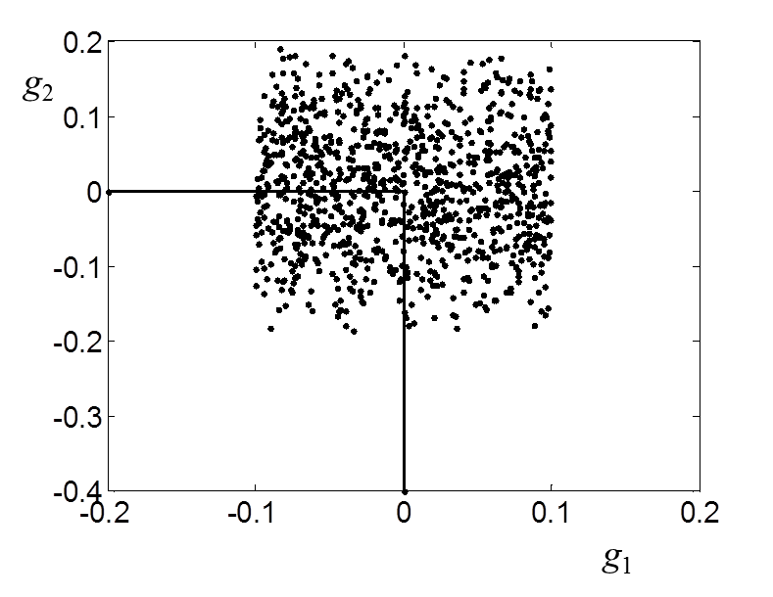
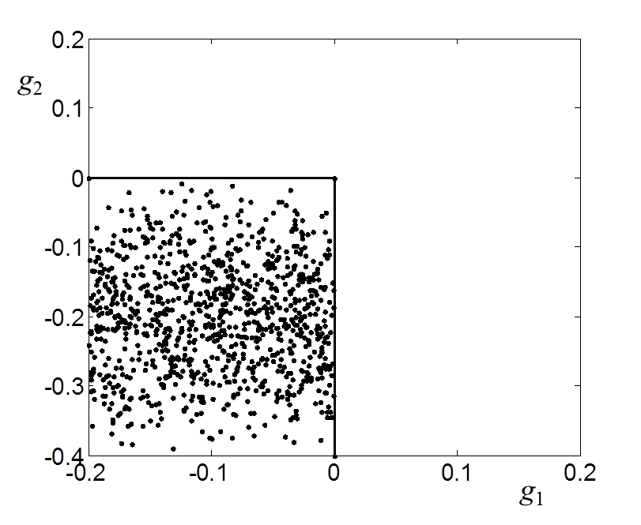
Numerical Example*: SQP-RO
Monte Carlo simulation:
Deterministic case
Solution
x & f | Deterministic | Robust
x₁ | 0.5 | 0.45
x₂ | 0.5 | 0.45
x₃ | 0.5 | 0.4
x₄ | 0.5 | 0.4
f | 9.020 | 9.245
Monte Carlo simulation:
Robust case
*Siddiqui, S., Azarm, S., and Gabriel, S., 2011, “A Modified Benders Decomposition Method for Efficient Robust Optimization under Interval Uncertainty,” Structural and Multidisciplinary Optimization, 44(2), pp. 259-275.

Slide 58
A-SQP-RO: Utopian Box
If x is subject to box constraints in the form of lb≤x≤ub, and if |lb|=|ub|=x_{b}, then we may rewrite x as a Hadamard product:
x₂
y₂
: original box
x₁
: Utopian box
: (y_{1max}, y₂), optimal for y₁
: (y₁, y_{2max}), optimal for y₂
0
y₁
: (y_{1max}, y_{2max}),Utopian point
y_{imax} defined as those y_{i}’s that maximize (minimize) (y_{i}+v_{i})² forms the vertex of Utopian box.
Writing in elements

Slide 59
Difference between SQP-RO and A-SQP-RO

Slide 60
Numerical Example*: A-SQP-RO
Solution
x & f | SQP-RO | A-SQP-RO
x₁ | -1.44 | -1.37
x₂ | 0.34 | 0.35
f | -1.7728 | -1.7287
Final solution: both feasibility robust and performance robust
Iteration1: constraint contours
*Siddiqui, S., Azarm, S., and Gabriel, S., 2011, “A Modified Benders Decomposition Method for Efficient Robust Optimization under Interval Uncertainty,” Structural and Multidisciplinary Optimization, 44(2), pp. 259-275.

Slide 61
Numerical Example: S-MOO 1

Slide 62
Three-Objective S-MOO 3

Slide 63
Numerical Example: S-MDO 2

Slide 64
GP Modeling of Performances vs. Compression Ratio
GP modeling for simulation model
Original and predicted results for training data
Original and predicted results for testing data

Slide 65
GP Modeling of Performances vs. Compression Ratio

Slide 66
Gaussian Process Modeling of Friction loss vs. Tolerance
Problem description
Cd: Critical dimensions
Modeling, MDO
Cd of compression ratio
Compression ratio
Cd of friction loss
Friction loss
Problem definition
Dimensions of CR
Compression ratio
Improve performance
s.t. constraints
Shared dimensions
Output: optimal tolerances & corresponding performances
Friction loss
Improve performance
s.t. constraints
Dimensions of FL

Slide 67
Gaussian Process Modeling of Friction loss vs. Tolerance
Problem description
24.50 mm
[-0.0085, -0.0025]
2.00 mm
[-0.009, -0.004]
26.50 mm
[0.0025, -0.0075]

Slide 68
GP Modeling of Performances vs. Compression Ratio
Statistics of prediction results
Statistics of prediction results
77.5% : none of the three objectives have errors > 5.1%
18.9% : one of the three objectives have errors >5.1%
3.6% : two or three of the objectives have errors > 5.1%

Slide 69
Gaussian Process Modeling of Friction loss vs. Tolerance
GP modeling results: for simulation data
There are few simulation data that did not fit well.
The not well fit data are with the smallest friction loss outputs, i.e., 0.21 kW and 0.22 kW.
However, the maximum variation of the friction loss instead of the minimum friction loss is considered in MDO tolerance design

Slide 70
Gaussian Process Modeling of Friction loss vs. Tolerance
Computational results
x_{1_1} | x_{1_2} | x_{1_3} | x_{1_4} | x_{1_5} | x_{1_6} | x_{1_7} | x_{1_8} | x_{1_9}
V₁ (mm³) | V₂ (mm³) | r_{c} (mm) | l (mm) | H (mm) | h (mm) | Radius of Main bearing bore | Radius of Main bearing shaft | Thickness of Main bearing shell
x_{2_1} | x_{2_2} | x_{2_3}
Clearance of the piston friction pair (mm) | Clearance of the main bearing friction pair (mm) | Clearance of the connecting-rod friction pair (mm)
x_{2_2} = x_{1_7 –(} x_{1_8 +} x_{1_9)}

Slide 71
Gaussian Process Modeling of Friction loss vs. Tolerance
Computational results
Main bearing shaft
r₁ = 24.50 mm
[-0.0085, -0.0025]
Main bearing shell
θ₁ = 2.00 mm
The maximum variation of friction loss appears @ the minimum clearance:
[-0.009, -0.004]
Main bearing bore
R₁= 26.50 mm
[0.0025, -0.0075]

Slide 72
Multi-disciplinary Tolerance Design
Pareto Front and Constraint region
2.80000003
2.79999998

